Slide 1
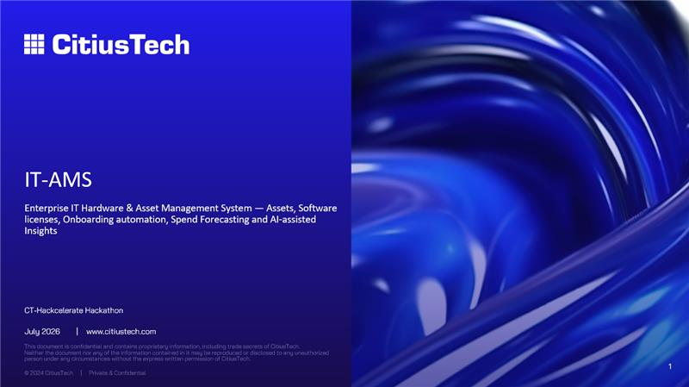

Slide 2

Problem Statement
Current gaps are limiting visibility, cost governance, and operational control
The organization faces asset management challenges driven by fragmented data sources, limited lifecycle visibility, manual processes, and disconnected inventory, procurement, and license management systems.
01
Inefficient utilization
Delayed visibility impacts allocation, recovery, and investment decisions.
Need
02
Compliance exposure
A unified, governance-driven platform providing a single source of truth across assets, inventory, procurement, and licenses.
Scattered records increase audit effort, reporting risk, and governance gaps.
03
Limited cost control
Budget visibility and software license optimization remain difficult without centralized tracking.
2
Notes:
[Sources]
Template background sourced from attached file: CitiusTech PPT Template_ Extra Light.pdf.

Slide 3
Introduction & Benefits
Centralized Asset Management enables visibility, control, compliance, and optimization
Asset Management provides a centralized framework to govern, track, and optimize assets throughout their lifecycle, enabling end-to-end visibility, cost optimization, compliance, operational efficiency, and data-driven decision-making.
Visibility
Cost Control
Compliance
Single view of ownership, usage, status, and accountability.
Improved spend governance, utilization, and license optimization.
Traceable, audit-ready records and stronger governance.
Efficiency
Decision Support
Accountability
Reduced manual reconciliation and faster reporting.
Actionable dashboards for timely business decisions.
Defined ownership across lifecycle and procurement stages.
3
Notes:
[Sources]
Template background sourced from attached file: CitiusTech PPT Template_ Extra Light.pdf.

Slide 4
Current Challenges
Key limitations impacting transparency, planning accuracy, and audit readiness
Fragmented Data
Manual Reconciliation
Lifecycle Visibility Gaps
Asset, inventory, and license data is spread across multiple systems, resulting in inconsistent records.
Manual validation increases operational effort, errors, and reporting delays.
Limited visibility into ownership, utilization, movement, warranty, and retirement stages.
License Tracking Limitations
Audit Readiness Challenges
Disconnected Procurement
Limited insight into license allocation, utilization, availability, and unused licenses.
Disparate records and manual controls increase audit effort and compliance complexity.
Procurement and asset management are not fully integrated, limiting forecasting and investment control.
4
Notes:
[Sources]
Template background sourced from attached file: CitiusTech PPT Template_ Extra Light.pdf.

Slide 5
Proposed Solution
Unified platform for lifecycle, inventory, procurement, license, and compliance governance
Single Asset Platform
Asset Lifecycle
Inventory Management
Procurement Tracking
End-to-end governance from procurement to disposal.
Real-time view of asset availability, location, and status.
Demand, approvals, orders, budgets, and asset capitalization.
License Governance
Audit & Compliance
Analytics & Reporting
Allocation, consumption, renewals, and reclamation.
Traceability, controls, evidence, and readiness.
Dashboards, trends, exceptions, and management insights.
5
Notes:
[Sources]
Template background sourced from attached file: CitiusTech PPT Template_ Extra Light.pdf.

Slide 6
Key AI Features
Intelligent capabilities for automation, forecasting, governance, and insights
01
AI Data Normalization
02
Automated Reconciliation
Detects inconsistent asset records and supports rationalized master data.
Matches assets across endpoint, inventory, procurement, and license sources.
03
Predictive Lifecycle Insights
04
License Optimization
Forecasts refresh cycles, warranty risks, and asset demand.
Identifies unused, underused, and over-allocated licenses.
05
Compliance Risk Alerts
06
Conversational Insights
Highlights missing ownership, stale records, and audit risk indicators.
Supports natural-language queries for asset, license, and compliance status.
6
Notes:
[Sources]
Template background sourced from attached file: CitiusTech PPT Template_ Extra Light.pdf.

Slide 7
Business Benefits
Measurable outcomes from centralized and AI-enabled asset intelligence
Improved Visibility
Cost Optimization
Audit Readiness
Single source of truth for inventory, ownership, utilization, and compliance.
Better control over procurement spend, license utilization, and investments.
Traceable records reduce audit preparation effort and compliance exposure.
Operational Efficiency
Decision Support
Governance & Control
Automation reduces reconciliation effort and accelerates reporting cycles.
Dashboards and AI insights enable faster, data-driven decisions.
Standardized processes improve accountability across the asset lifecycle.
7
Notes:
[Sources]
Template background sourced from attached file: CitiusTech PPT Template_ Extra Light.pdf.

Slide 8
Future Enhancements
Scalable capabilities to mature asset governance and continuous optimization
▪
Integrated connectors across endpoint, inventory, procurement, finance, and license systems.
▪
Predictive forecasting for refresh demand, licenses, warranty exposure, and budget usage.
▪
Automated governance workflows for allocation, reclamation, approvals, and exceptions.
▪
Mobile and self-service access for status tracking and ownership validation.
▪
Advanced AI assistant for recommendations, proactive risk nudges, and conversational analytics.
8
Notes:
[Sources]
Template background sourced from attached file: CitiusTech PPT Template_ Extra Light.pdf.

Slide 9
Recommended Adoption Roadmap
Phased approach from manual tracking to intelligent asset governance
1. Discover
2. Consolidate
3. Integrate
4. Automate
5. Optimize
Map data sources, stakeholders, process gaps, and reporting needs.
Build single repository with cleansing and ownership validation.
Connect inventory, endpoint, procurement, budget, and license sources.
Enable reconciliation, alerts, approvals, reclamation, and audit workflows.
Use AI insights for forecasting, lifecycle planning, and cost governance.
Outcome: Unified, intelligent, and audit-ready Asset Management ecosystem.
9
Notes:
[Sources]
Template background sourced from attached file: CitiusTech PPT Template_ Extra Light.pdf.

Slide 10

Notes:
[Sources]
Template background sourced from attached file: CitiusTech PPT Template_ Extra Light.pdf.

